Slide 1
Postcolonial theory

Slide 3
"to read her work is not so much to confront a system as to encounter a series of events” (Robert Young)
‘the British version constructs a continuous and homogenous narrative in terms of heads of state and British administrators...India can then be represented, in the other sense by its imperial masters'.
‘He is actually engaged in consolidating the Self of Europe by obliging the
native to cathect the space of the Other on his home ground..... He is worlding
their own world, which is far from mere uninscribed earth, anew, by obliging them to domesticate the alien as Master’.
(Spivak, 1999: 211).

Slide 4
Epistemic violence
The cartesian self
- consciousness comes from outside and not inside your head
- our sense of self is constructed through language

Slide 5
Subaltern
Term used by Antonio Gramsci
Those groups subjected to the hegemony of the ruling classes - peasant, workers
Focus on different histories (subaltern versus dominant classes)
Subsequently appropriated within postcolonial studies by the Subaltern studies group
Subordination in South Asian countries (Bangladesh, India, Pakistan, Afghanistan, Iran) - quantifed in terms of class, caste, age gender or office

Slide 6
"calling the place of the investigator into question remains a meaningless piety in many recent critiques of the sovereign subject".
Foucault is a brilliant thinker of power-inspacing, but the awareness of his topographical reinscription of imperialism does not inform his presuppositions.
According to Foucault and Deleuze...the oppressed, if given the chance can speak and know their conditions. On the other side of the international division of labour from localised capital, inside and outside the circuit of epistemic violence of imperialist law and education supplementing an earlier economic text, can the subaltern speak?
"white men saving brown women from brown men".

Slide 7
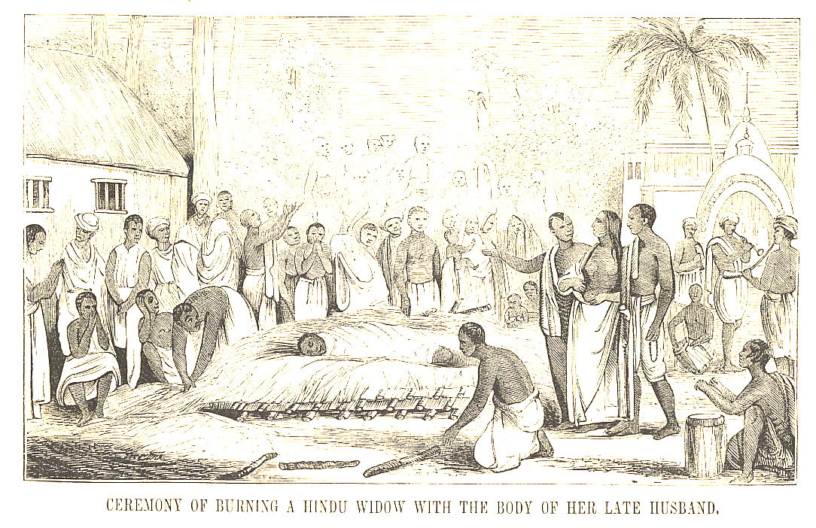
From A Pictorial History of China and India, 1851.

Slide 8
"an intoxicating ideology of self-sacrifice - as in war - the dubious place of the free will of the constituted sexual subject as female was successfully effaced".
"between patriarchy and imperialism, subject-constitution and object formation, the figure of the women disappears, not into a pristine nothingness, but into a violent shuttling which is the displaced figuration of the Third World Woman caught between tradition and modernisation”
‘As the discourse of what the British perceive as heathen ritual is
sublated...into what the British perceive a crime, one diagnosis of female
free will is substituted for another....the dubious place of the free will of the
constituted sexed subject as female was successfully efface’.

